Slide 1


HTTPS, TLS, SSL: Securing the Digital World
In today's interconnected world, the security and privacy of online interactions are paramount. This presentation delves into the foundational protocols—HTTPS, TLS, and SSL—that underpin a secure digital environment. With over 95% of all web traffic encrypted as of late 2023, understanding these technologies is crucial for data integrity, fostering user trust, and even optimizing search engine performance. Join us as we explore their evolution, functionality, and critical importance in safeguarding your digital presence.
by Abdullah Nooristani

Slide 2
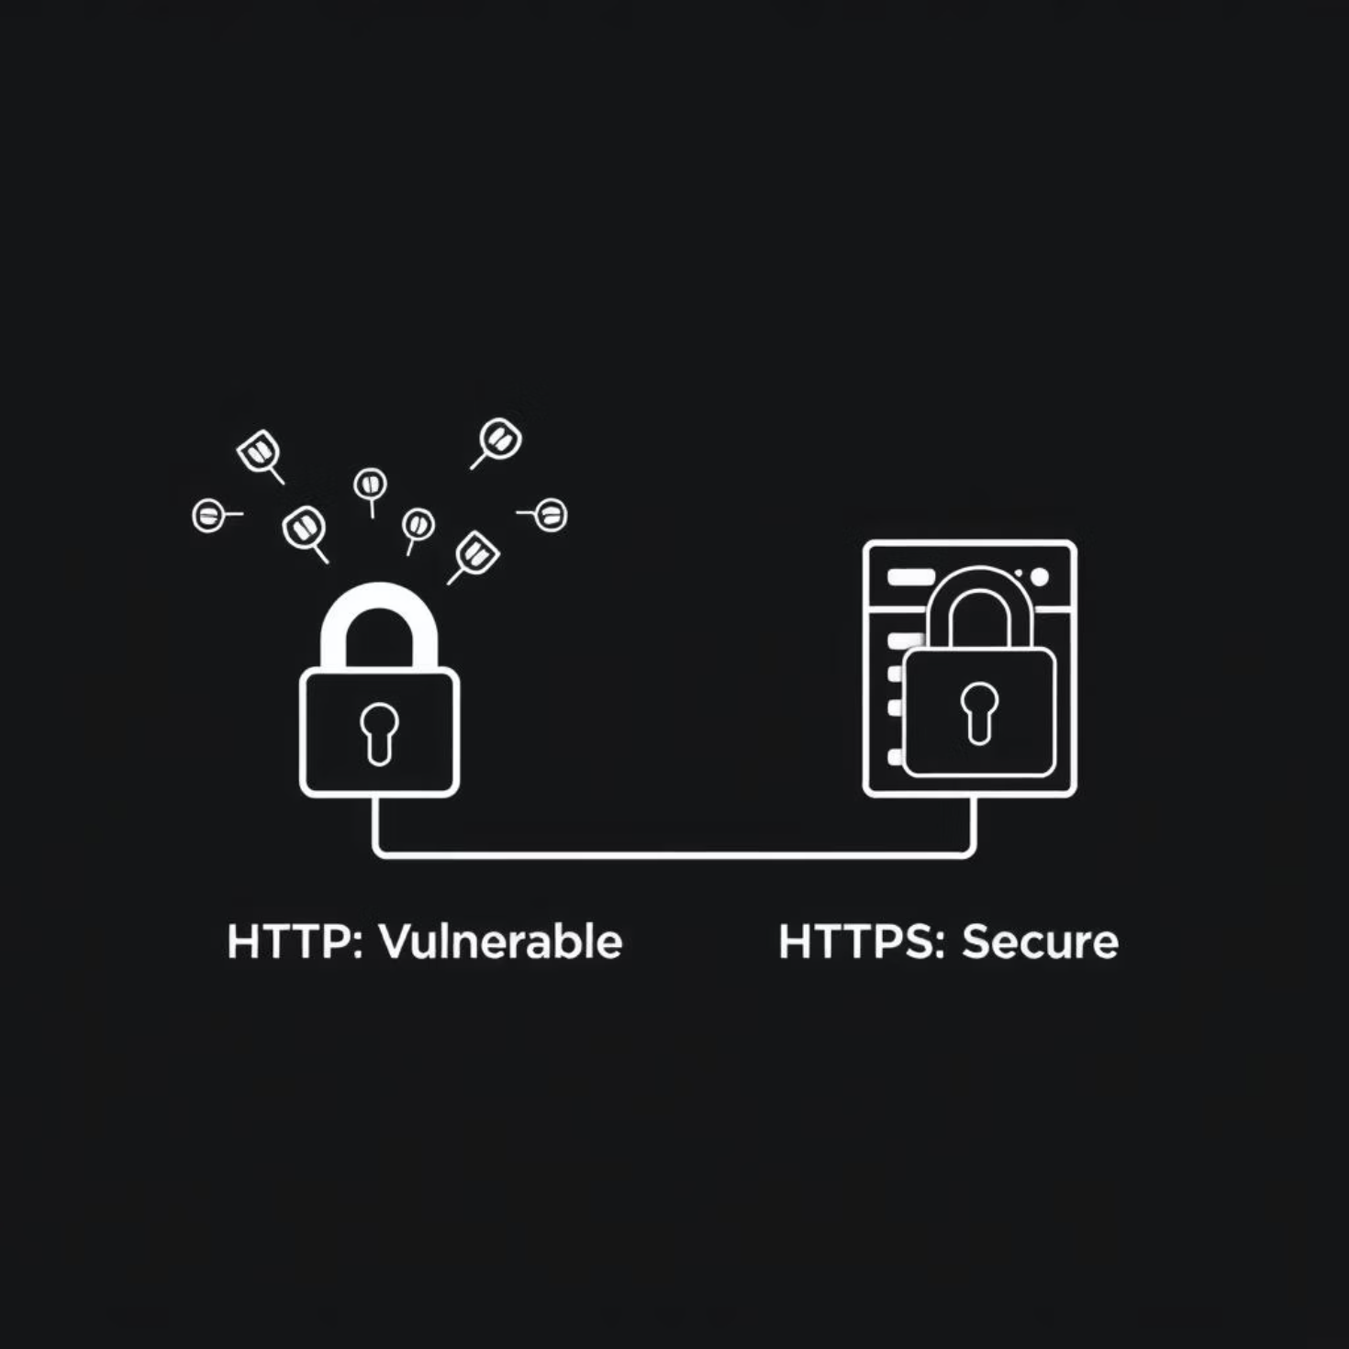
HTTP: The Unsecured Foundation
Before the era of secure connections, HTTP (Hypertext Transfer Protocol) served as the standard for data transfer on the web. Defined by RFC 2616 in 1999, it operated predominantly over Port 80.
The fundamental limitation of HTTP is its unencrypted nature: data is transmitted in plain text, making it vulnerable to interception. Furthermore, HTTP offers no inherent mechanism to verify the identity of the server, leaving users susceptible to impersonation and phishing attacks. It was clear a more robust solution was needed to protect sensitive information.

Slide 3





The Perils of Unencrypted HTTP
Eavesdropping
Sensitive data like passwords, credit card numbers, and personal information are transmitted in plain text, making them easily visible to unauthorized third parties who intercept the network traffic.
Data Tampering
Malicious actors can alter data packets in transit. This could involve injecting unwanted advertisements, redirecting users to fake sites, or modifying transaction details without detection.
Man-in-the-Middle (MITM) Attacks
Attackers can secretly relay and potentially alter the communication between two parties who believe they are directly communicating. This allows for interception and manipulation of data.
Lack of Trust
Without encryption or server authentication, users have no assurance that they are communicating with the legitimate website or that their data remains private, leading to a significant erosion of trust.

Slide 5

The Dawn of SSL: A Legacy of Security (and Vulnerabilities)
The first significant step towards securing web communication came with the introduction of Secure Sockets Layer (SSL). Developed by Netscape in 1994, with SSL 2.0 being its first public release, it offered initial encryption and authentication capabilities.
While groundbreaking for its time, SSL suffered from inherent design flaws and critical vulnerabilities. Notable examples include the POODLE attack in 2014, which exploited weaknesses in SSL 3.0. Consequently, SSL 2.0 and 3.0 were formally deprecated by RFC 7568 in 2015, paving the way for its more secure successor.

Slide 6




TLS: The Modern Standard for Secure Communication
Successor to SSL
Transport Layer Security (TLS) emerged as the secure successor to SSL, meticulously designed to address the vulnerabilities and limitations found in its predecessor.
Current Versions
TLS 1.2 (RFC 5246, 2008) and the more robust TLS 1.3 (RFC 8446, 2018) are the current industry standards, with TLS 1.3 seeing over 60% adoption.
Secure Channel Establishment
At its core, TLS establishes a secure communication channel through a complex "handshake" process, negotiating encryption keys and parameters between the client and server.

Slide 7
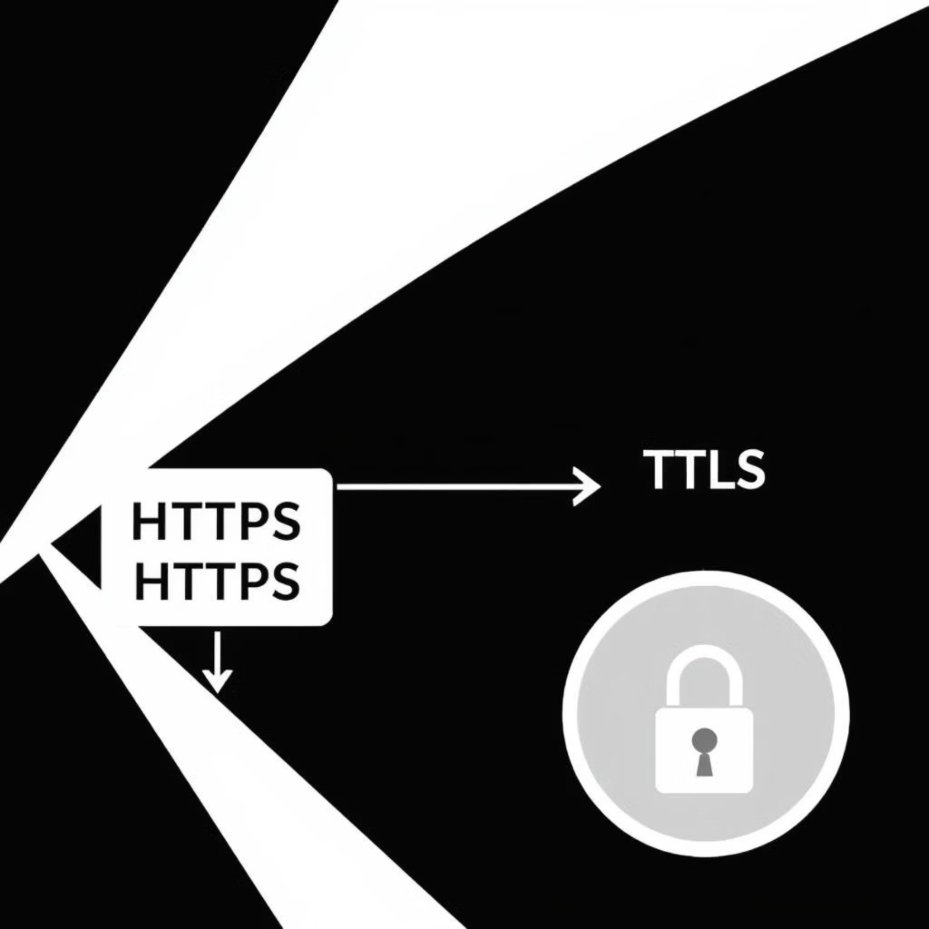
How HTTPS Works: HTTP + TLS = Secure Web
HTTPS (Hypertext Transfer Protocol Secure) is essentially HTTP combined with TLS (or its predecessor, SSL). While HTTP uses Port 80, HTTPS communicates over Port 443 by default, signifying a secure connection.
The bedrock of HTTPS is the digital certificate, issued by trusted Certificate Authorities (CAs) like Let's Encrypt or DigiCert. This certificate verifies the server's identity, ensuring authenticity. When you see the familiar "padlock" icon in your browser, it confirms that HTTPS is active, safeguarding your data's privacy and integrity.

Slide 8

Unpacking TLS: Core Components
Digital Certificates (X.509)
These electronic documents bind a public key to an organization's identity. Verified by Certificate Authorities (CAs), they are crucial for server authentication, ensuring you're connecting to the legitimate website.
Asymmetric Encryption (e.g., RSA, ECC)
Utilizing a pair of keys (public and private), asymmetric encryption is employed during the TLS handshake. It facilitates secure key exchange and authenticates the server's identity before the main data transfer begins.
Symmetric Encryption (e.g., AES-256)
Once the secure channel is established via the handshake, symmetric encryption takes over for bulk data transfer. Using a single shared key, it offers significantly faster encryption for large volumes of data.
Hashing Algorithms (e.g., SHA-256)
These algorithms generate fixed-size strings (hashes) from data. Any tampering with the data will result in a different hash, enabling the detection of unauthorized modifications and ensuring data integrity.

Slide 9
Why HTTPS is Non-Negotiable Today
Enhanced Security
Increased User Trust
SEO Benefits
HTTPS provides robust protection for user data, shielding it from interception, modification, and eavesdropping attempts. This is crucial for safeguarding sensitive information.
The visible padlock icon and "Secure" label in browsers immediately build user confidence, signaling that the website is legitimate and their connection is private.
Google officially uses HTTPS as a ranking signal, prioritizing secure websites in search results. This directly impacts visibility and organic traffic.
Performance Optimization
Compliance & Regulations
HTTPS is a prerequisite for modern web protocols like HTTP/2 and HTTP/3 (QUIC), which offer significant performance improvements through features like multiplexing and reduced latency.
Many industry standards and data privacy regulations, such as PCI DSS for payment processing and GDPR for data protection, mandate the use of HTTPS.

Slide 10

Implementing HTTPS: Best Practices
1
Obtain a TLS Certificate
Acquire a certificate from a trusted Certificate Authority (CA). Options range from Domain Validation (DV), Organization Validation (OV), to the more stringent Extended Validation (EV) certificates.
2
Configure Server for HTTPS
Properly configure your web server software, such as Apache, Nginx, or IIS, to serve content securely over HTTPS, specifying the certificate paths.
3
Redirect HTTP to HTTPS
Implement 301 (Permanent) redirects on your server. This ensures all incoming HTTP traffic is automatically and securely rerouted to the HTTPS version of your site.
4
Implement HSTS (HTTP Strict Transport Security)
HSTS is a security policy that forces browsers to only communicate with your website over HTTPS, even if a user types HTTP in the URL.
5
Use Latest TLS Versions
Regularly update your server configuration to disable outdated and vulnerable protocols like SSL 2.0/3.0, TLS 1.0, and TLS 1.1, prioritizing TLS 1.2 and especially TLS 1.3.

Slide 11

Conclusion: The Encrypted Future of the Internet
HTTPS, robustly underpinned by Transport Layer Security (TLS), has cemented itself as the indispensable standard for secure web communication. It is the cornerstone that ensures the privacy, integrity, and authenticity of billions of daily online interactions, from casual browsing to sensitive financial transactions.
As browsers increasingly flag unencrypted HTTP sites as "Not Secure," the impetus for HTTPS adoption continues to grow. The journey towards a fully encrypted internet is ongoing, with continuous research into advanced cryptographic methods like post-quantum cryptography, promising to further harden the internet against future threats and ensure a more secure digital tomorrow.

